Slide 1
Computer Vision-based Driver Scoring System
組員：
Tugdual LEVASSEUR 、胡晋毓、蔡奇倫

Slide 2
目錄
Introduction
Motivation
Last progress
Experiment and Final results
Conclusion
Future work

Slide 3
Introduction

Slide 4
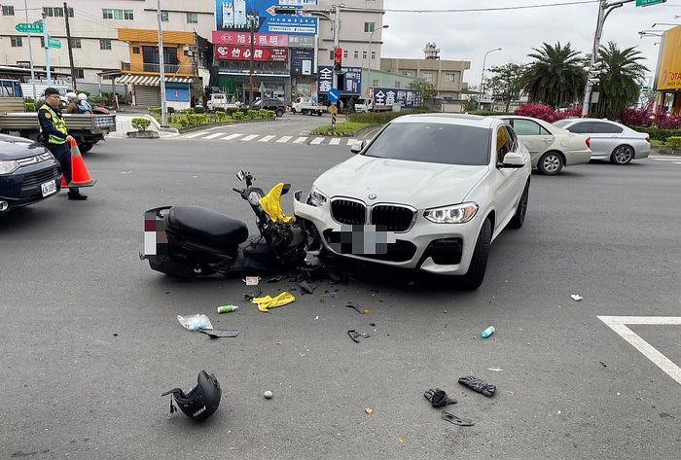
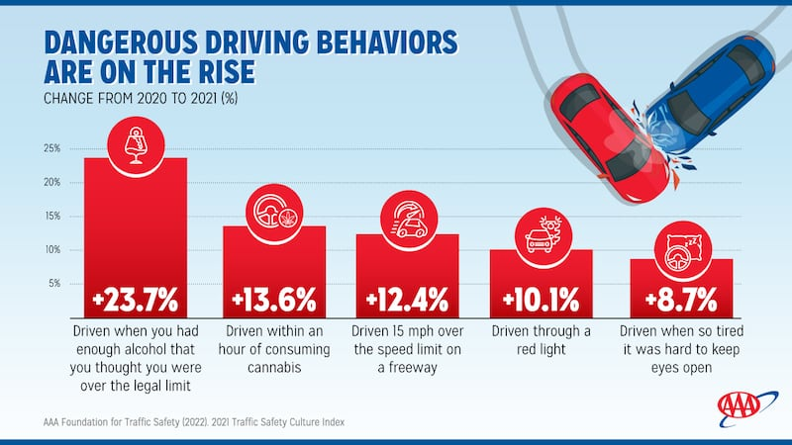
Introduction- Motivation
Project relevance
Increase of accident
Increasing dangerous behavior
Goal
Propose a system to score driving

Slide 5
Introduction- Last progress
Should detect cars, motorcycles
Need Draw the lane lines and determine specific areas
Need to add a driving score
Define which behavior we assess

Slide 6
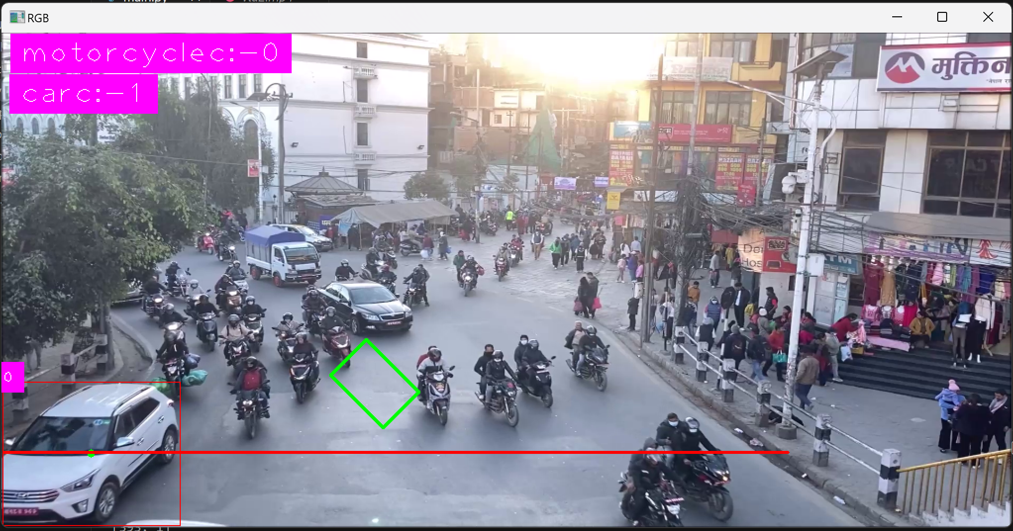
Last progress
Label ID
Car detecting

Slide 7
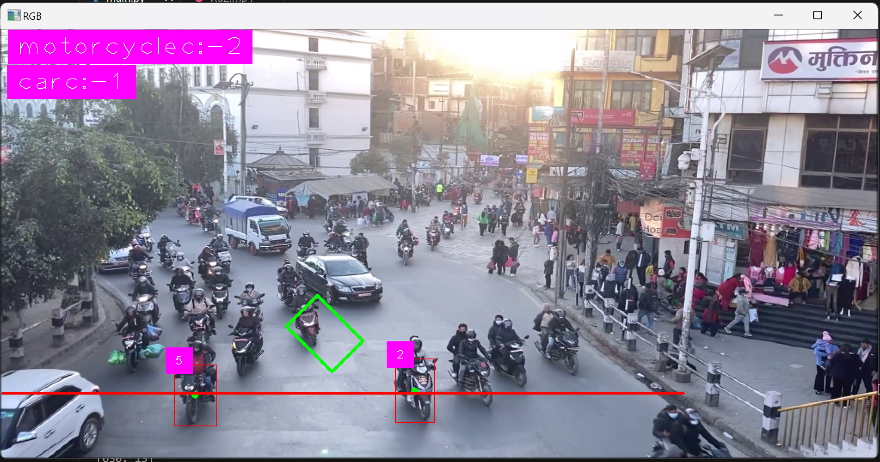
Last progress
Label ID
Label ID
Motorcycle detecting

Slide 8
Last progress
Specific area (waiting space or parking spot)
Counter Line

Slide 9
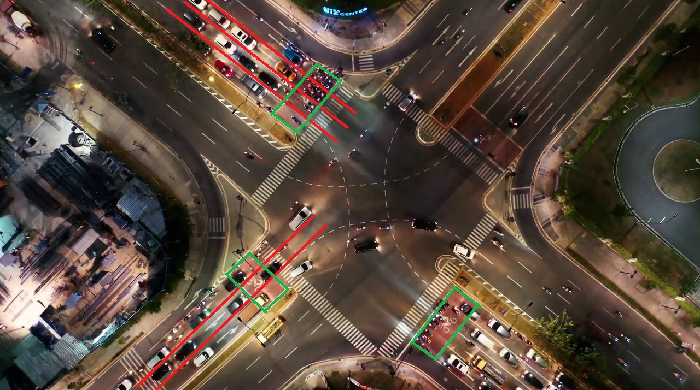
Last progress
Draw the lane lines and determine specific areas

Slide 10
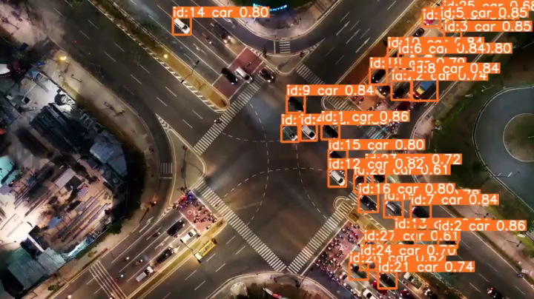
Detection
Draw the lane lines and determine specific areas

Slide 11
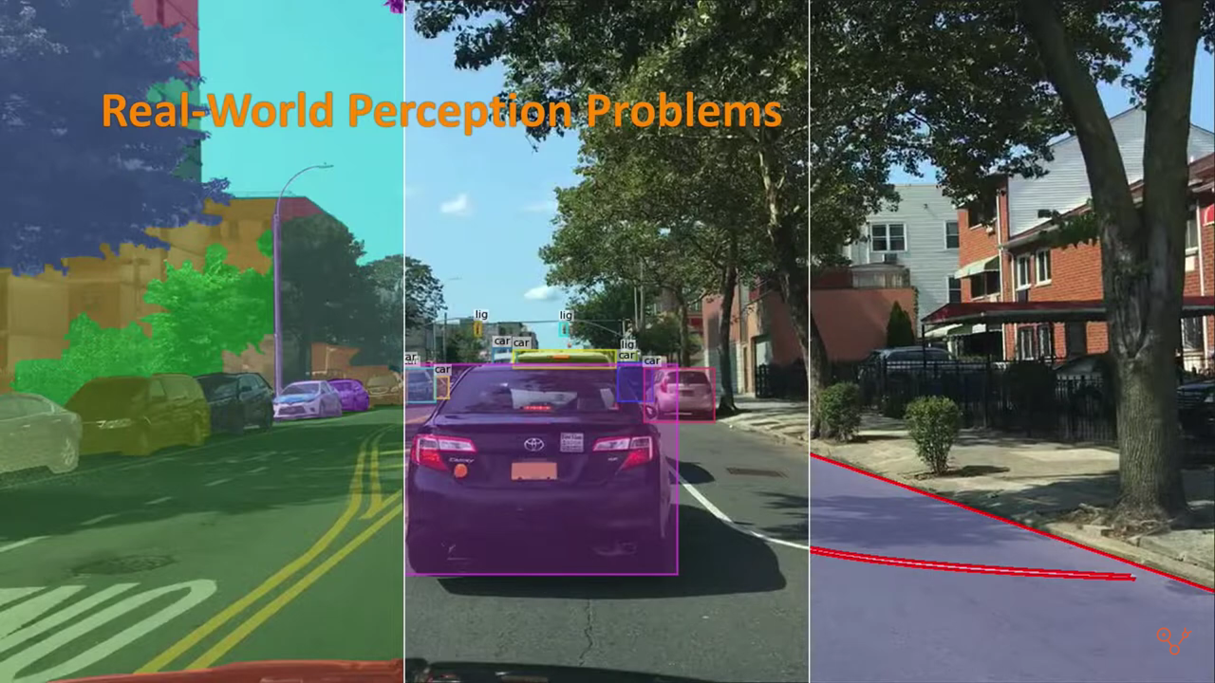
Last progress
Driver Scoring
Arbitrarily change the lanes ?
Too close to the front car ?

Slide 12
Experiment and Final results

Slide 13
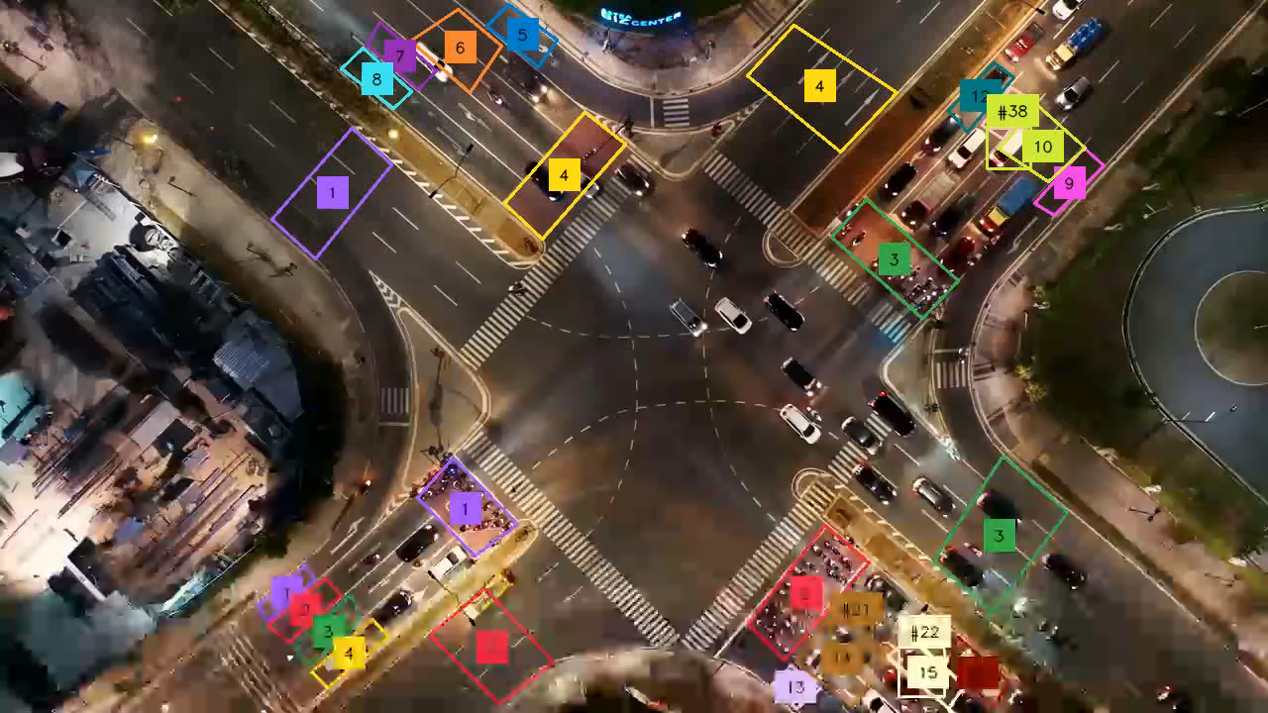
Experiment and Final results - violations at intersections

Slide 14
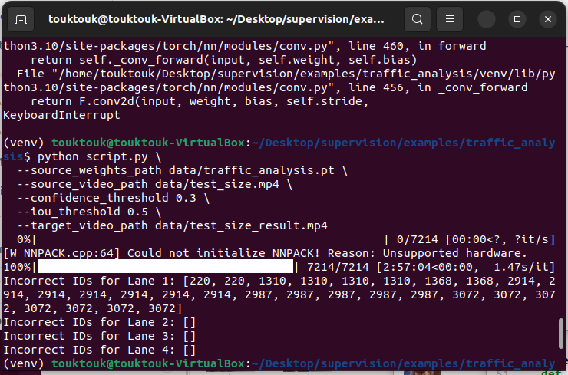
Experiment and Final results - violations at intersections
See the video uploaded beside the powerpoint

Slide 15
Experiment and Final results - Hough's transformation
See the video in the presentation given in class (too big for here)
Notes:
This is a simple implementation of lane detection using Hough's transformation.
The red box represents the scope of the Hough conversion.

Slide 16
Conclusion and Future work
Notes:
Conclusion and Future work

Slide 17
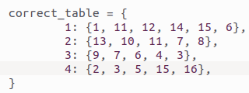
Conclusion
We built a system that can use cameras to detect violations at intersections.
Manually define the lanes and areas to monitor and
Manually decide “correct configuration”
The quality of the video used affects detection and tracking performance.
Car stopping in wrong area or traffic jam can be confused

Slide 18
Future work
Build a personal driving score system
Use the first-person point of view
Implement a GUI to easily define the areas to monitor
Improve speed to detect in real-time
Implement communication to send report on the faulty driver
Detect automatically the lanes and the areas (Taxi, pedestrian, buses, scotter and bike …)
Improve car detection and implement other vehicle detection
Assess other behaviors (traffic light compliance, smooth driving…)

